Slide 1
MIC MRA Workshop 2014 update
Pieter Robben
ACB
ACB

Slide 2
MIC MRA Workshop 2014
The workshop took place on 19-20 February 2014
Approximately 150 attendees
A broad number of topics were presented and covered several regulatory regions such as the US, the EU and Japan

Slide 3
MIC MRA Workshop 2014
Topics included:
Latest updates on FCC regulations
Accreditation/designation requirements for foreign certification bodies under the Japanese Radio Law and Telecommunications Business Law
Latest information on the Radio Equipment Directive
Latest updates on the Japan Radio Law
Body SAR regulations

Slide 4
MIC MRA Workshop 2014
Topics included:
Latest updates on the Japan Telecommunications Business Law
Guidance for VOIP devices (Japan)
Introduction of MIC market surveillance
APEC TEL MRA Task Force Training Session (Market Surveillance Guideline)
False and fake test reports
Comparison of Body SAR measurements

Slide 5
Latest updates on Japan Radio Law
Introduction about the objectives and processes of the Japan Radio Law
Requirements for the registration of certification bodies for the Japan Radio Law
Overview of registered certification bodies for the Japan Radio Law; currently 12 domestic and 12 foreign certification bodies are registered as a certification body

Slide 6
Latest updates on Japan Radio Law
Overview of the number of certificates issued on a yearly basis for domestic and foreign certification bodies
As of December 2013; 7552 (domestic RCB’s) and 1560 (foreign RCB’s) were issued
Overview of categories of specified radio equipment
Testing methods of specified radio equipment (includes the link on the MIC Radio Use website to the location of these testing procedures)

Slide 7
Latest updates on Japan Radio Law
New additions/changes to the Japan Radio Law:
Digital wireless radio microphones (August 2013)
Body SAR regulations (April 2014)
LTE-Advance (January 2014)

Slide 8
Latest updates on Japan Radio Law
New additions/changes to the Japan Radio Law:
Changes in UWB requirements (January 2014)
Note: changes in UWB requirements were published by means of Ministerial Ordinance No. 122 of 25 December 2013. One significant change is the removal of Ordinance Regulating Radio Equipment, Article 49.27(4): “4) The radio equipment which is not use an alternating-current source shall not be emit the radio wave until a receiving the signal from another radio equipment using an alternating-current source.” Location of Ministerial Ordinances (in Japanese only): http://www.soumu.go.jp/menu_hourei/s_shourei.html

Slide 9
Latest updates on Japan Radio Law
Labeling (current situation):
Host equipment which contains certified radio modules can not be labeled with the certification numbers of the certified radio modules
It is recommended , but not mandatory, to place a label on the host device which indicates the presence of one or more certified radio modules in the host device

Slide 10
Latest updates on Japan Radio Law
Labeling (current situation):
Example of labeling which indicates the presence of one or more certified radio modules: 当該機器には電波法に基づく、技術基準適合証明等を受けた特定無線設備を装着している。

Slide 11
Latest updates on Japan Radio Law
Labeling (future situation):
Host equipment which contains one or more certified radio modules can be labeled with the certification numbers of the certified radio modules
A label can be placed on the host device which indicates the presence of one or more certified radio modules in the host device and includes the certification numbers of the certified radio module(s)

Slide 12
Latest updates on Japan Radio Law
Labeling (future situation):
Example of labeling which indicates the presence of one or more certified radio modules and contains the certification number: 当該機器には電波法に基づく、技術基準適合証明等を受けた特定無線設備を装着している。

Slide 13
Market surveillance TTE equipment
MIC carries out market surveillance every year
MIC purchases samples of TTE equipment as they are available on the market
Labeling of TTE equipment is examined
Conformity to technical standards is examined
In cases where non-compliances are found, MIC requests the vendor or dealer to take corrective actions
MIC will publish notices in cases where non-compliances have been found

Slide 14
Market surveillance TTE equipment
Examples of found non-compliances are:
Undocumented changes in certified equipment
Wrong test methods applied, false/fake test report was created which was used to obtain a certification number
Model name of certified equipment was changed. However, the change in model name was not presented to the certification body
Emergency call configuration/test method violations

Slide 15
Market surveillance radio equipment
MIC carries out market surveillance every year
MIC purchases samples of radio equipment as they are available on the market
Labeling of radio equipment is examined
Conformity to technical standards is examined
In cases where non-compliances are found, MIC requests the vendor or dealer to take corrective actions
MIC will publish notices in cases where non-compliances have been found

Slide 16
Market surveillance radio equipment
Examples of found non-compliances are:
Undocumented changes in certified equipment
Labeling not correct
Not complying with the technical requirements (antenna power/spurious emissions too high)
In 2012 1% of all issued certificates were sampled
Non-compliances were detected in 4% of the cases

Slide 17
Body SAR regulations
Head SAR regulations and limits (2 W/kg) existed since June 2002 for mobile phones, satellite cellular phones and broadband wireless access devices
Body SAR regulations and limits now have been added to the existing regulation
Announcement date was 23 August 2013
Enforcement date was 1 April 2014

Slide 18
Body SAR regulations
Limits for Body SAR are 2 W/kg for the body and 4 W/kg for arms and legs for radio equipment which may be operated at a separation distance of less than 20 cm to the body
The SAR value is averaged in 10 grams of tissue over a 6 minute period
During the SAR measurements all transmitters within the same enclosure must be taken into account
Radio equipment consuming less than 20 mW of electrical power are excluded and deemed to comply

Slide 19
Body SAR regulations
Body SAR regulations and limits apply to mobile phones, satellite cellular phones and broadband wireless access devices, including tablets and other devices which may contain radio devices and which may be used as a mobile phone and/or broadband wireless access device

Slide 20
Body SAR regulations
“Stand alone” 2.4 GHz WLAN/low power radio equipment is excluded of the scope of the Body SAR regulation
“Stand alone” 5 GHz WLAN/low power radio equipment is excluded of the scope of the Body SAR regulation
PHS and digital cordless phones is excluded of the scope of the Body SAR regulation
The exclusion only applies for “stand alone” operation

Slide 21
Body SAR regulations
The exclusion from the scope of the Body SAR regulation does not apply to 2.4/5 GHz WLAN/low power radio equipment and PHS/Digital cordless phones when combined in the same enclosure with radio transmitters which may act as a mobile phone, satellite cellular phone and/or broadband wireless access device

Slide 22
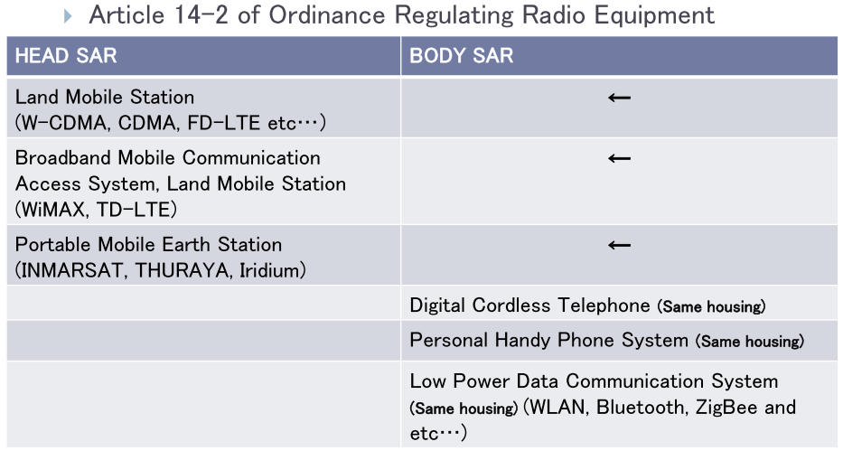
Body SAR regulations
Picture courtesy of. DSP Research Inc.

Slide 23
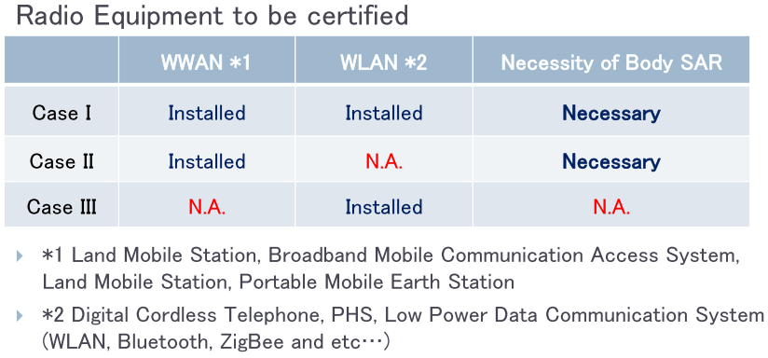
Body SAR regulations
Picture courtesy of. DSP Research Inc.

Slide 24
Body SAR regulations
Radio modules:
Radio modules, such a USB sticks, which have their own enclosure, a defined integral antenna position and a well defined connector can be evaluated for Body SAR as a “module”
Radio modules which are intended to be integrated into host equipment cannot be evaluated for Body SAR. The evaluation for Body SAR needs to be carried out on the combined equipment of host and radio module

Slide 25
Body SAR regulations
Radio modules:
Radio modules which are intended to be integrated in a host system can be certified as a “radio module” under the Japan Radio Law. Such a certificate would not be valid for the Body SAR regulation
A manufacturer of devices which contain certified radio modules must submit an application to a certification body in order to obtain a certificate which covers the Body SAR regulation for the complete device

Slide 26
Body SAR regulations
Radio modules:
In such a case the certification body is allowed to omit part of the assessment (since the radio modules have been previously certified for the “radio part”) and only assess compliance with the Body SAR regulation
Point of attention: “Each registered certification body decides whether it will omit some parts of the examination, what parts to omit, and so on.”

Slide 27
Body SAR regulations
Test procedures for Body SAR are based on IEC 62209-2
Tissue parameters for the simulated body are the same as the tissue parameters used in the EU, the defined frequency range is a bit different
Since the test method is based on IEC 62209-2 head tissue parameters are used for creating the body liquid
Typically, the use of head tissue parameters during Body SAR measurements leads to an over-estimation of the measured SAR values

Slide 28
Body SAR regulations
ICCJ in Japan is currently working on guidelines on required operational modes during Body SAR testing, how to deal with simultaneous transmissions, test case reduction, etc.

Slide 29
Useful links
MIC Japan Radio Use Website http://www.tele.soumu.go.jp/e/
MIC MRA Workshop 2009 http://www.tele.soumu.go.jp/j/sys/equ/mra/20/english/pro_e/english.htm
MIC MRA Workshop 2010 http://www.tele.soumu.go.jp/j/sys/equ/mra/21/english/pro_e/english.htm
MIC MRA Workshop 2012 http://www.tele.soumu.go.jp/j/sys/equ/mra/23/english/pro_e/english.htm
MIC MRA Workshop 2013 http://www.tele.soumu.go.jp/j/sys/equ/mra/24/english/pdf/index.htm

Slide 30
Questions ?

Slide 31
Thank you for your attention

